Slide 1



Engineering Education for Today’s Classroom
The Infinity ProjectSM
Bringing Engineering
Education to Schools
Across the Country
The Caruth Institute for Engineering Education
infinity-project.org

Slide 2
History of the Program
Started in 1999 as a partnership between Southern Methodist University Lyle School of Engineering, high-tech corporate leaders, and leading national engineering faculty.
  Purpose: Respond to the national challenge of exciting and preparing young students for advanced education in engineering, technology, math, and science.

Slide 3
Curriculum Development Team
Developed in partnership with subject matter experts in the field of engineering and education
Ongoing multi-million dollar investment in curricula materials

Slide 4


What is The Infinity ProjectSM?
Award Winning Engineering Education Program
Emphasizes innovation in addition to problem solving
Appropriate for:
  Early College Students
  High School Students (10th – 12th)
  Intermediate School Students (6th – 9th)
  Outreach Camp Students
Hands-on application of math & science to topics of interest to students
  Internet, cell phones, digital music, digital imaging, robotics, health, environment

Slide 5
Program Breadth
450+ High Schools/Middle Schools/Colleges in 38 States
    Public, Private, Magnet Schools
Gaining International Interest
    Australia, Bahamas, Ireland, Israel, Lebanon, Mexico, Portugal, Vietnam
Alabama
Alaska
Arkansas
Arizona
California
Colorado
Connecticut
District of Columbia
Florida
Georgia
Hawaii
Idaho
Illinois
Iowa
Kansas
Kentucky
Louisiana
Maryland
Massachusetts
Maine
Michigan
Mississippi
Missouri
Nevada
New Jersey
New Mexico
New York
North Carolina
Ohio
Oklahoma
Oregon
Pennsylvania
Tennessee
Texas
Utah
Virginia
West Virginia
Wisconsin

Slide 6




Infinity Project Partners:
Universities, corporations, government agencies and many others
Notes:
Mention universities:
Georgia Institute of Technology,
Rose-Hulman Institute of Technology,
Rice University
Texas A&M University
University of Texas at Austin
University of Texas at El Paso
Prairie View A&M
University of Michigan
Santa Clara
University of Houston
and many others.

Slide 7
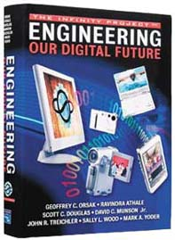



The Complete Solution
Instructional Materials
  High School/College Textbook
  Student Manual
  Instructor’s Guide
  Daily Lesson Plan
  Presentation Slides
  On-line Classroom Support
Classroom Technology
  Infinity Project Technology Kit
    Turns PC Into “Engineering Design Platform”
    Lego Mindstorms NXT Kit

Slide 8
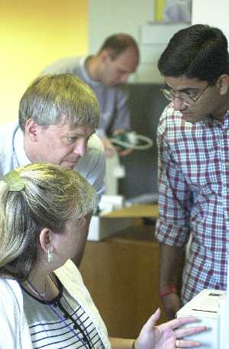
The Complete Solution
Professional Development
  Week-long summer sessions
  Instruction in use of text, hardware, software, and technology associated with curriculum
  Taught by Master Infinity Project Instructor
  Provides curricular instructional materials
    Instructional Text with Notes
    Daily Lesson Plan Guide
    Presentation Slides
    Activities & Exercises with Solutions
    Module Exams
    On-line Classroom Support
    Access to Professional Development Extensions & Videos

Slide 9

Student Impact
Findings from Qualitative Assessment prepared for
Texas Education Agency
  Instructors report that students …
    Obtain deeper understanding of math and science
    Improve performance in other math and science classes
    Increase willingness to take other math and science classes
    Increase desire to pursue engineering and/or technology degrees in college
  Students report …
    83% “considering engineering as a career”
      40 times higher than the typical 2%
    95% “learned new math concept”
    94% would “recommend course to a friend”

Slide 10
Elements to Success
Two Key Elements for The Infinity Project’s Success
1. Award winning, high quality program
2. Easy for schools to implement
Added benefits:
  low cost
  works with existing teacher base
  significant classroom support
  high impact

Slide 11
Engineering Curricula
Course Title | Level | Teacher Certification | Availability
Engineering Design Year-long + curriculum focused on math & science concepts behind electrical, mechanical, environmental, biomedical engineering Pre-requisites: Algebra II, one lab-based science | 10-12 | Math Science Tech Ed | Current
Math for Innovators Year-long curriculum focused on application of math to engineering concepts Pre-requisite: Algebra II | 11-12 | Math Tech Ed | Summer 2011
Engineering for Today’s Intermediate School Year-long curriculum focused on math & science concepts behind electrical, mechanical, civil, environmental, biomedical engineering | 6-9 | Math Science Tech Ed | Current

Slide 12
High School Engineering Curriculum
Engineering Design
  Designed for Students in 10th – 12th Grade
    Pre-requisites: Algebra II, one lab-based science course
  Reinforces Math & Science Behind Electrical, Mechanical, Environmental, Biomedical Engineering
  Provides Year-long+ Curriculum & Instructional Material
College-prep Curriculum | Presentation Slides
Instructional Text with Notes | Module Exams
Exercises/Activities with Solutions | On-line Classroom Support
Daily Lesson Plan Guide | Week-long Training
Notes:
12

Slide 13
High School Engineering Curriculum
Engineering Design
  Modular Curriculum Provides 2-year Engineering Program
  10th – 11th Grade: Engineering Design I
    Focused on Electrical Engineering
    Engineering Our Digital Future (36 weeks)
      Pre-requisites: Algebra II/concurrent enrollment, one lab-based science course
  11th – 12th Grade: Engineering Design II
    Focused on Mechanical, Environmental, Biomedical Engineering
    The Challenge of Roving Callisto (9 weeks)
    Engineering Earth (6 weeks)
    The Human Machine (6 weeks)
      Pre-requisites: Algebra II, Physics, Chemistry
  Modular Curriculum Provides 2-year Engineering Program
Notes:
13

Slide 14
Engineering Design Outline
Electrical Engineering (36 weeks)
  Engineering Our Digital Future - explores the fundamentals of engineering and technology in the information and communications age.
Mechanical Engineering (9 weeks)
  The Challenge of Roving Callisto – focuses on engineering principals necessary to create & design a robot to roam the surface of Jupiter’s moon.
Environmental Engineering (6 weeks)
  Engineering Earth – utilizes science, technology, and math to support human needs and develop ecological solutions.
Biomedical Engineering (6 weeks)
  The Human Machine – links biology, physics chemistry, and math together to investigate and improve the human condition.

Slide 15
Engineering Design
Knowledge and Skills |  | IP HS Modules
 |  | The Human Machine | The Challenge of Roving Jupiter | Engineering Earth | Engineering our Digital Future
1 | The student, for at least 40% of instructional time, conducts engineering field and laboratory activities using safe, environmentally appropriate, and ethical practices. | P | P | P | P
2 | The student applies knowledge of science and mathematics and the tools of technology to solve engineering design problems. | P | P | P | P
3 | The student communicates through written documents, presentations, and graphic representations using the tools and techniques of professional engineers. | P | P | P | P
4 | The student recognizes the history, development, and practices of the engineering professions. | P | P | P | P
5 | The student creates justifiable solutions to open-ended problems using engineering design practices and processes. | P | P | P | P
6 | The student manages an engineering design project. | P | P | P | P

Slide 16
High School Engineering Curriculum
Math for Innovators
  Designed for Students in 11th – 12th Grade
    Pre-requisites: Algebra II
  Provides Year-long Curriculum & Instructional Material
  Students Learn and Apply Math to Engineering Concepts
    Robotics, Fluid Power and Pneumatics, Physics of Machines, Electricity, Statics and Structures, Manufacturing & Production, Quality Assurance
College-prep Curriculum | Presentation Slides
Instructional Text with Notes | Module Exams
Exercises/Activities with Solutions | On-line Classroom Support
Daily Lesson Plan Guide | Week-long Training
Notes:
16

Slide 17
Math for Innovators Outline
Electrical Engineering
  Review digital audio systems, create sounds and music, digitize and compress audio, and learn how re-mastering and special effects can be used to design the ultimate digital music system.
Mechanical Engineering
  Learn about the physics of machines, fluid power, electricity, statics and structures while building and programming a robot to accomplish a factory task.
Environmental Engineering
  Explore the entire energy cycle and its environmental impact on a living village and design an efficient transportation system for food delivery.
Biomedical Engineering
  Explore biological systems while developing genetic modifications to ensure animal survival during various environmental changes. Learn how to acquire and process data and design a system for monitoring heart rate and respiration during exercise.

Slide 18
Math for Innovators Knowledge & Skills
1 | The student uses mathematically based hydraulics concepts to measure and find pump output, understand pressure versus cylinder force, and understand flow rate verses cylinder speed.
2 | The student uses mathematical concepts of structure design to define and describe statics, acquire data, apply concepts of moments and bending stress, and apply concepts of truss design and analysis.
3 | The student understands the properties of trigonometry in spatial applications.
4 | The student understands the concepts of design processes with multi-view computer-aided drafting and design drawings for facilities layouts, precision part design, process design, computer-aided manufacturing for lathe, and injection mold design.
5 | The student calculates electronic quantities and uses electrical measuring instruments to experimentally test their calculations.
6 | The student applies mathematical principles of pneumatic pressure and flow to explain pressure versus cylinder force, apply and manipulate pneumatic speed control circuits, and describe maintenance of pneumatic equipment, centrifugal pump operation and characteristics, data acquisition systems, pump power, and pump system design.
7 | The student applies mathematical principles of manufacturing processes in lathe operations and computer numerical control mill programming and calculates speeds and feeds for machining tools, including special cutting tools.
8 | The student applies mathematical principles of material engineering, including tensile strength analysis, data acquisition systems, compression testing and analysis, shear and hardness testing and analysis, and design evaluation.
9 | The student applies mathematical principles for mechanical drives, including levers, linkages, cams, turnbuckles, pulley systems, gear drives, key fasteners, v-belt drives, and chain drives.
10 | The student applies mathematical principles of quality assurance, including using precision measurement tools, statistical process control, control chart operation, analysis of quality assurance control charts, geometric dimensioning and tolerancing, and location, orientation, and form tolerances.
11 | The student applies mathematical principles of robotics and computer programming of robotic mechanisms in point-to-point assembly, calculating working envelope and computer system conversions.

Slide 19
Intermediate School Curriculum
Engineering for Today’s Intermediate School
  Complete Solution for Introducing STEM
  Flexible, Rigorous, Relevant Curriculum
  Designed for Students in 6th – 9th Grade
  Reinforces Math & Science Behind Electrical, Mechanical, Civil, Environmental, Biomedical Engineering
  Provides Year-long Curriculum & Instructional Material
  Students Apply Concepts Through Hands-on Design Projects
    Loudspeaker, Robot, Bridge, Rocket, Prosthetic Leg
College-prep Curriculum | Presentation Slides
Instructional Text with Notes | Module Exams
Exercises/Activities with Solutions | On-line Classroom Support
Daily Lesson Plan Guide | Week-long Training
Instructional Text with Notes | Module Exams
Exercises/Activities with Solutions | On-line Classroom Support
Daily Lesson Plan Guide | Week-long Training
Presentation Slides
Notes:
19

Slide 20
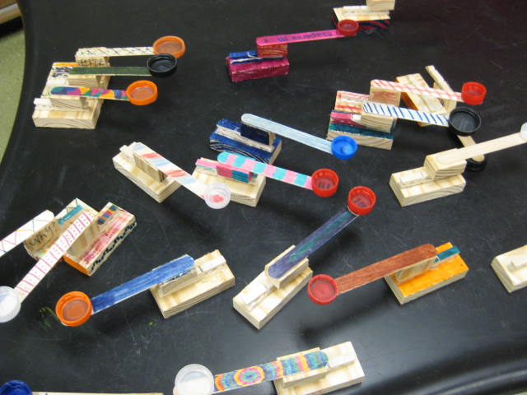
Intermediate Curriculum Outline
Introduction to Engineering Design
  Learn how engineers apply a nine-step design algorithm to create objects students use every day
Sound Engineering – Making Great Sounds
  Discover how technology is used to make music and movies sound great
Digital Imaging – Pixel Yourself in the Digital Domain
  Learn how technology is used to create and manipulate digital images
Machines – Making Things Work
  Examine the basics of machine technology and how it has helped the development of civilization

Slide 21

Intermediate Curriculum Outline
Rocketry: Achieving Liftoff
  Explore the physics behind rocket motion. Discover
  where rocket engines get their power and understand
  rocket trajectories
Robots from Concept to Completion
  Learn the mechanical aspects of robots, how they move, manipulate objects and think
Watt’s Up in Power?
  Uncover the secrets behind electrical power generation and transmission
Structures – Building from the Ground Up
  Discover the concepts behind solid structures and their ability to stand the test of time

Slide 22

Intermediate Curriculum Outline
Engineering in the Natural World
  Increase awareness of environmental issues and how technology can be used to develop solutions
Global Climate Change - Engineering Our Planets Future
  Explore how the Earth’s climate is changing and how new technologies will meet the challenge
Imaging the Human Body
  Find out how modern medicine is using space age technology to better understand how the human body works
Engineering the Human Machine
  Learn how engineers & medical scientists are tackling human health issues and expanding our understanding of what it means to be human

Slide 23
The Infinity Project Advantage
Complete “turn-key” solution for implementing engineering into the secondary classroom
College-prep curriculum developed by subject matter experts in education and engineering
Flexible modular content can be taught as a stand-alone course or incorporated into existing STEM classes
Rigorous reinforcement of math & science concepts through hands-on engineering design projects
Relevant topics of interest to students
Prepares students for university level STEM courses

Slide 24
Becoming an Infinity School
Complete & submit Infinity Project application
  www.infinity-project.org/joinnow
Interview conducted with school principal & instructor
Schools acquire classroom technology & textbooks
Instructors attend Professional Development Institute
Course offered in fall

